Slide 1
影像處理期末報告
資碩工一 111753119 陳佳彣
資碩工一 111753127 蘇冠華
資碩工一 111753123 朱其霖
資碩工一 111753225 陳暐中

Slide 2
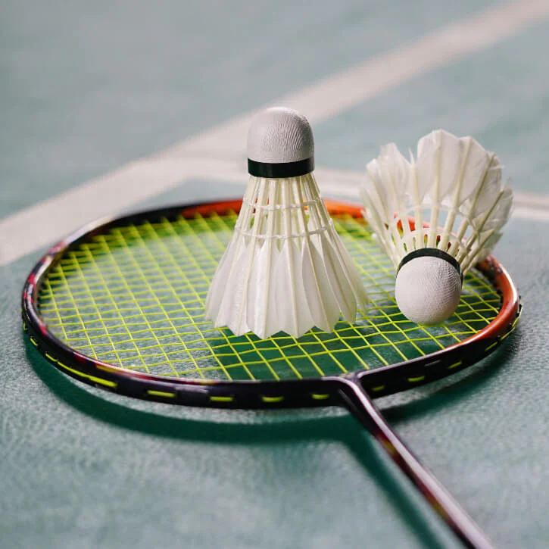
Contents
Competition Overview
Problem Description
Methods and Techniques
Court detection
Position detection
Ball tracing
Results and award
Challenges and Issues

Slide 3
1. Competition Overview
AICUP 2023 competition
Teaching Computer to Watch Badminton Matches - Taiwan's first competition combining AI and sports
[教電腦看羽球競賽]
2023/03~2023/5/17

Slide 4
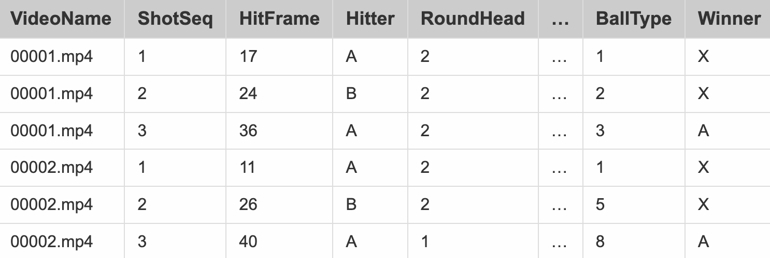
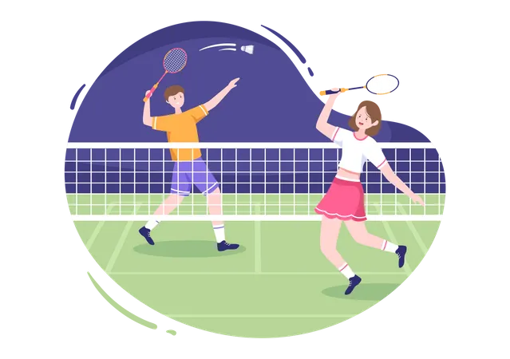
2. Problem Description
The result should be like:

Slide 5


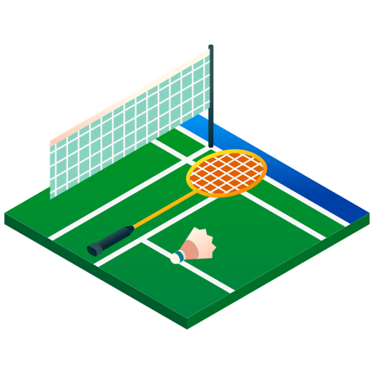
2. Problem Description
The dataset includes 15 annotation fields.
VideoName: Video serial number.
ShotSeq: The order of the shot in the rally.
HitFrame: The moment of the shot in the rally, in frames.
Hitter: Which player hit the ball , marked with A/B
A : Sited farther from the camera
B : Sited closer to the camera

Slide 6
2. Problem Description
The dataset includes 15 annotation fields.
BallHeight: The height of the hitting point, marked by 1/2
The hitting point is above the net
The hitting point is below the net
RoundHead: Whether the player has a round-head hitting action, marked by 1/2
Round-head hitting
No round-head hitting

Slide 7
2. Problem Description
The dataset includes 15 annotation fields.
Backhand: Whether the player's hitting action is backhand, marked by 1/2
Backhand hitting
Not backhand hitting
LandingX/LandingY: The projection on the court plane of the shuttlecock at the end of trajectory either hitted by the opponent or touch on the ground, in pixels

Slide 8
2. Problem Description
The dataset includes 15 annotation fields.
HitterLocationX/HitterLocationY: The location of the hitter, taking the toe of the habit foot as the coordinates in the picture, in pixels. If there is a jump, the coordinates projected onto the court plane are the answer.
DefenderLocationX/DefenderLocationY: The location of the defending player, similar to the location of the hitting player.

Slide 9
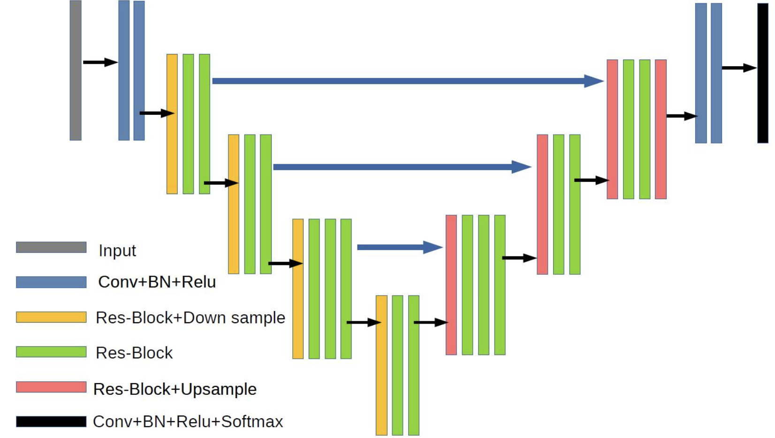
3. Methods and Techniques-TrackNetV2
Combine ResNet and U-Net to form network architecture
Image source : https://github.com/Chang-Chia-Chi/TrackNet-Badminton-Tracking-tensorflow2

Slide 10
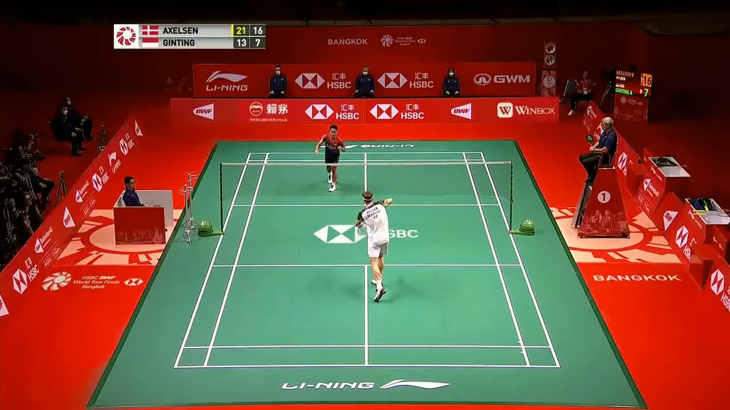
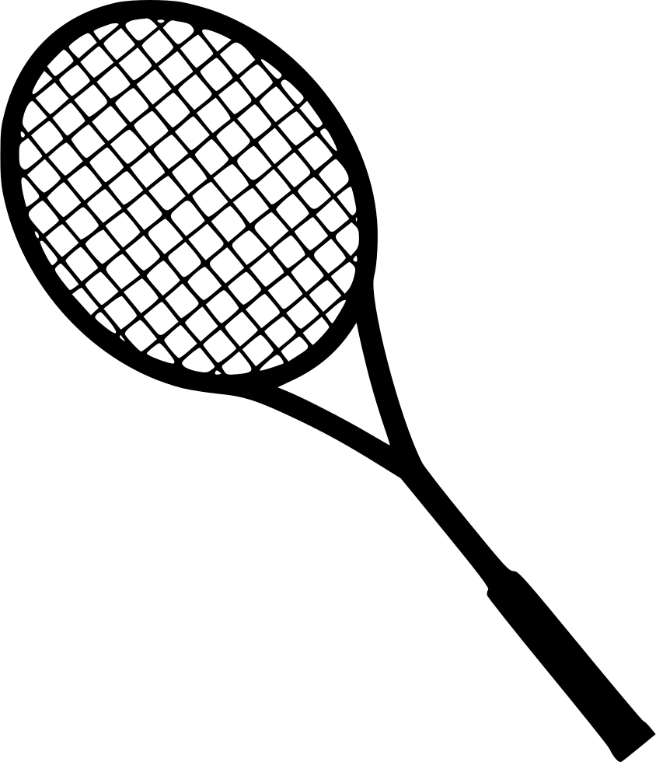

3. Methods and Techniques-TrackNetV2

Slide 11
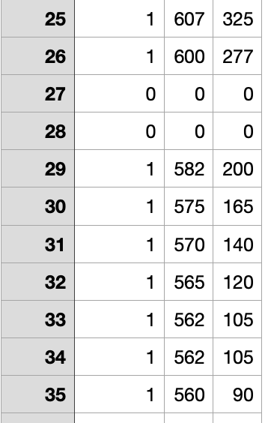
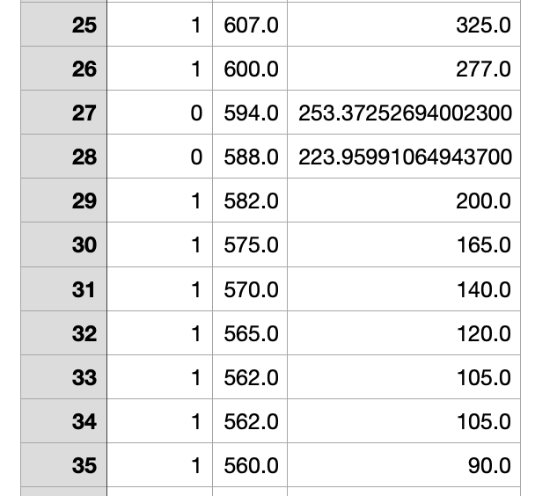
3. Methods and Techniques-TrackNetV2
Before denoise
After denoise

Slide 12
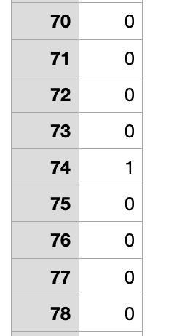
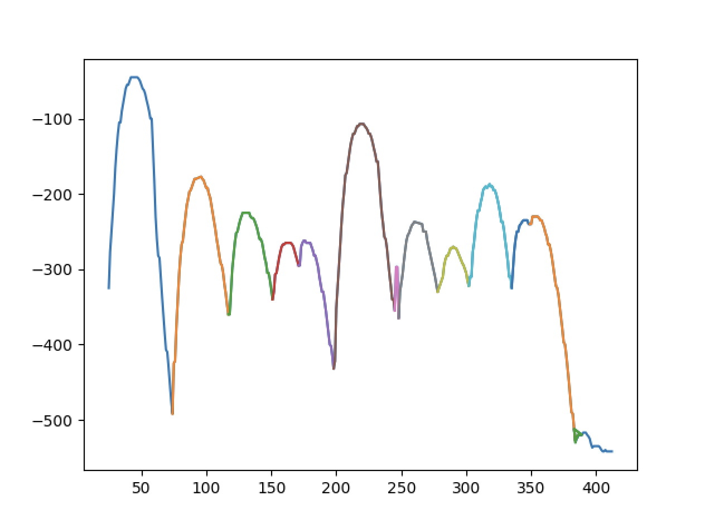
3. Methods and Techniques-TrackNetV2
Hit frame detection

Slide 13
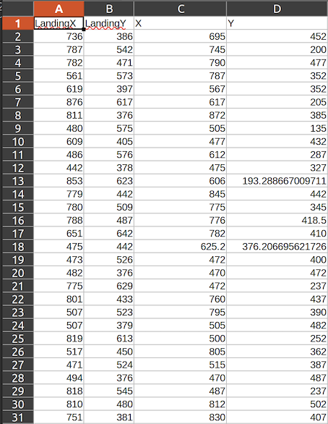
3. Methods and Techniques-Linear Regression
For each hit frame in the training dataset, we have the corresponding ground truth landing coordinates, which indicate the location of the shuttlecock transformed into plane coordinates.

Slide 14
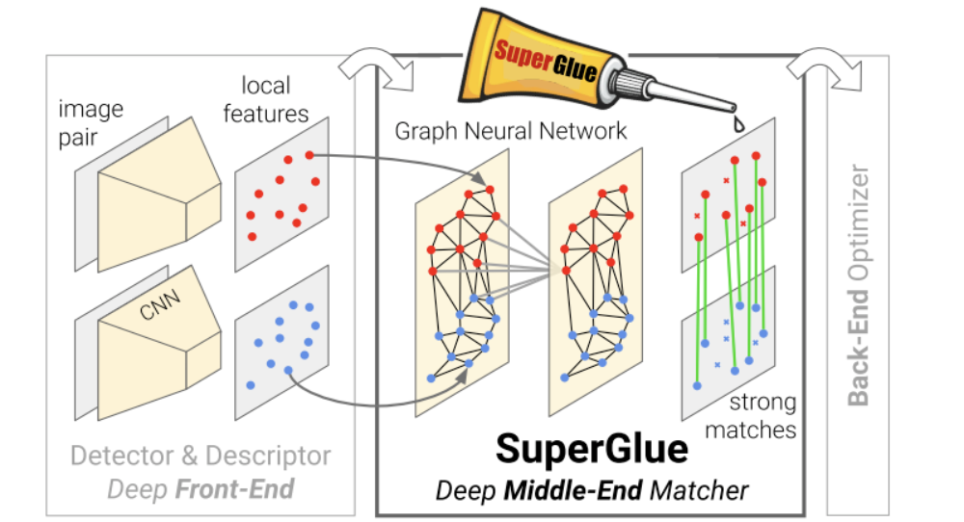
3. Methods and Techniques-Superglue
The feature extractor utilizes CNN to extract feature representations from images.
The matcher employs attention mechanisms (GNN) to compute the similarity and matching scores between feature points.
Image source : https://github.com/magicleap/SuperGluePretrainedNetwork

Slide 15
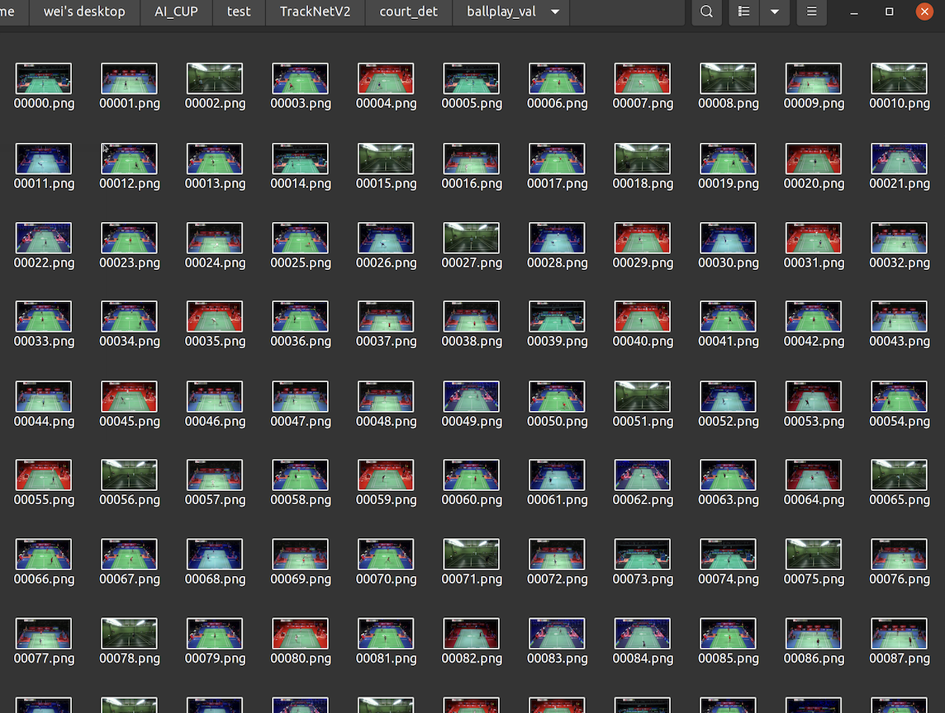
3. Methods and Techniques-Superglue
We automatically extract hit frames from the videos and save them as PNG image files for use in OpenPose pose estimation.

Slide 16
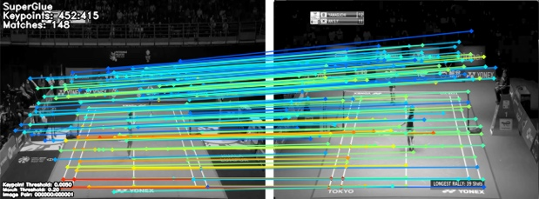
3. Methods and Techniques-Superglue
Using SuperGlue to find matching points and compute the transformation matrix.

Slide 17
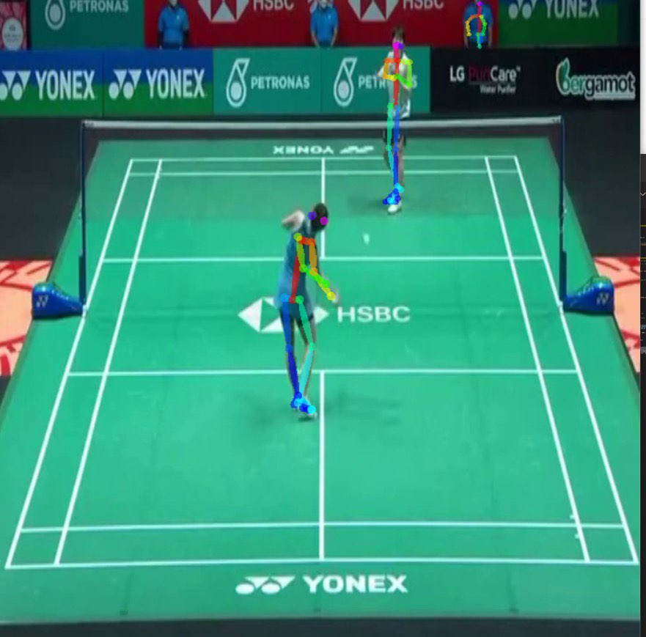
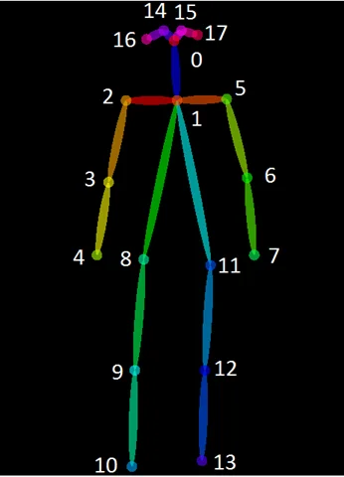
3. Methods and Techniques-Openpose
https://github.com/CMU-Perceptual-Computing-Lab/openpose
Notes:
在比賽中我們使用openpose做姿態辨識，並用hitFrame中羽球的座標及openpose的右腳尖做ㄨㄟ

Slide 18
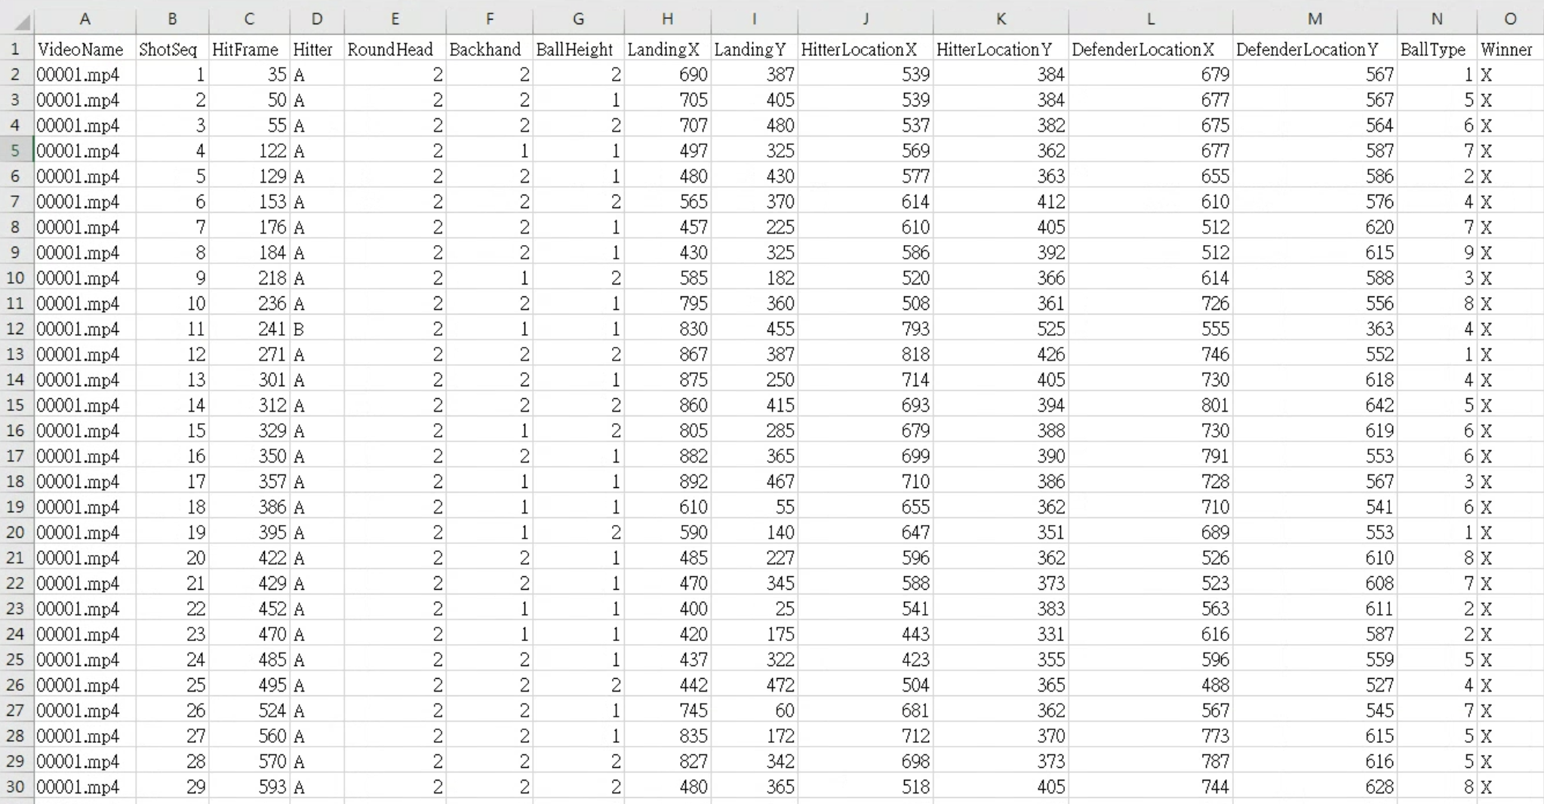
4. Result and Award

Slide 19

4. Result and Award
21/250組（前標）

Slide 20

5. Challenges and Issues - Hit Frame
We have applied noise reduction and smoothing techniques to the shot trajectory to minimize errors in our hit frames. However, we have observed that even with these steps, minor variations in the trajectory model can still be affected by slight measurement errors.

Slide 21
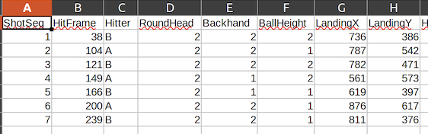
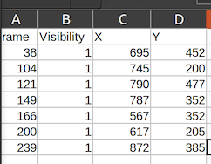
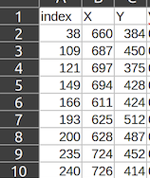
5. Challenges and Issues - Landing
Dimension coordinates
Coordinates without conversion
Coordinates after linear regression

Slide 22
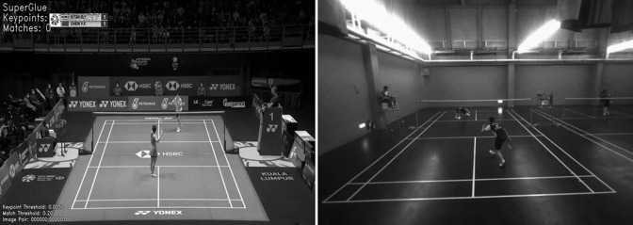
5. Challenges and Issues - Court Detection
Superglue :
International scene matching features
Superglue: International scene vs.
self-captured scene feature matching

Slide 23

Q & A

